Slide 1
Consumer As Information Ecosystem
Jerald Hughes
University of Texas Rio Grande Valley

Slide 2
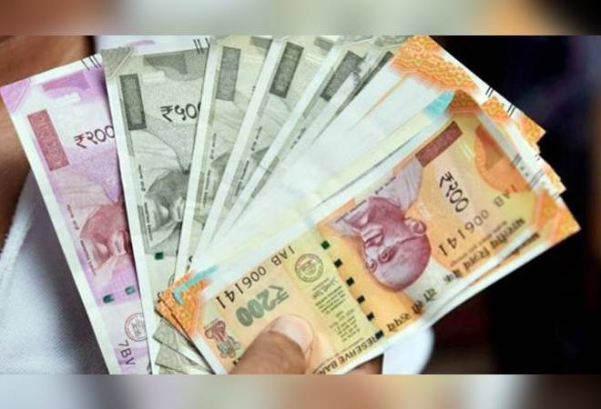
Consumer Behaviors: Rational, but also Irrational 1
How do consumers choose to pay?

Slide 3
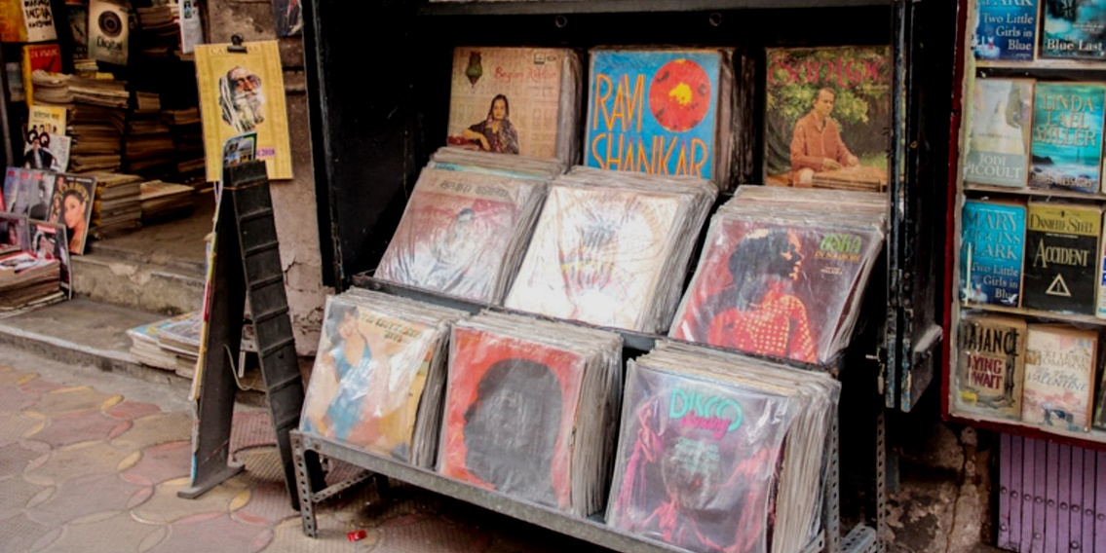
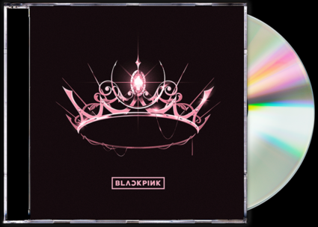
Consumer Behaviors: Rational, but also Irrational 2
Why do consumers choose LOWER quality products?
Why in the world are consumers buying more vinyl LP’s ???

Slide 4
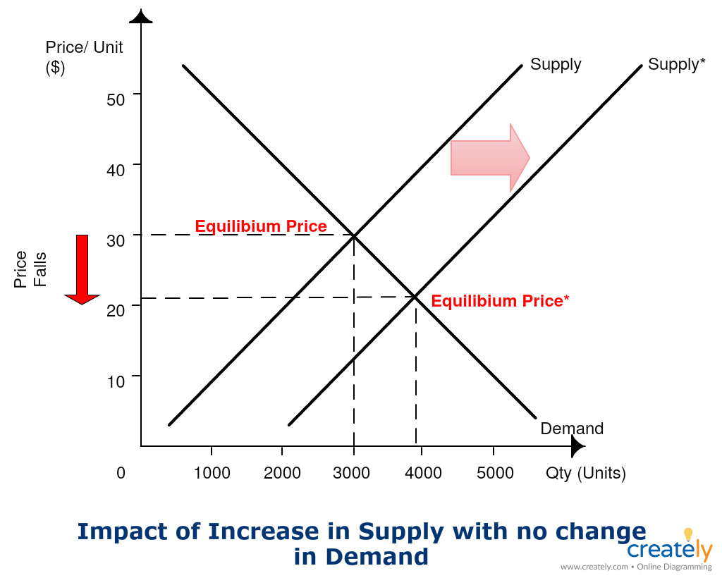
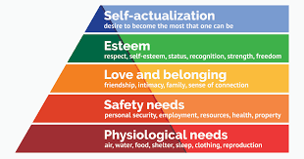
Modeling Consumer Behaviors 1
Model: “conceptual representation of a system of ideas, events or processes” (https://www.education.vic.gov.au/)
Paradigm: “a distinct set of concepts or thought patterns, including theories, research methods, postulates, and standards for what constitute legitimate contributions to a field.” (https://en.wikipedia.org/wiki/Paradigm)
Economic actors
Maslow’s Hierarchy of needs

Slide 5
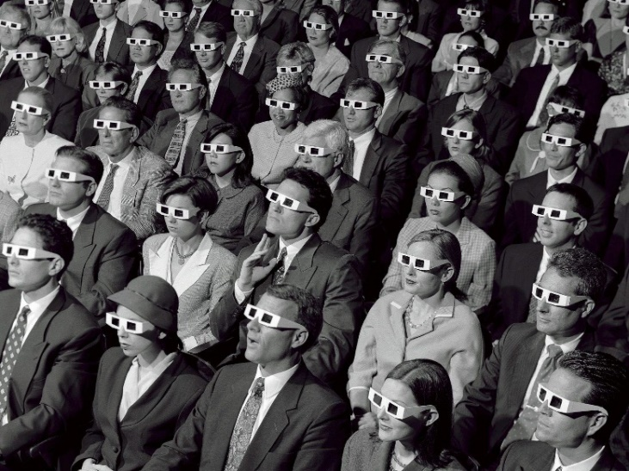
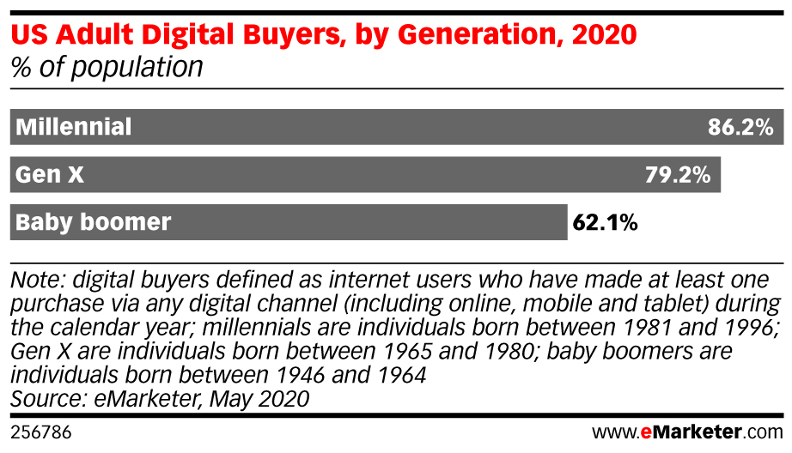
Modeling Consumer Behaviors 2
Audience
Websites today
Websites, 1996
Users
Demographic

Slide 6
Consumer behavior is changing quickly in response to swift technological change.
Need a framework for understanding consumers that is sufficient to the complexity of new conditions.

Slide 7
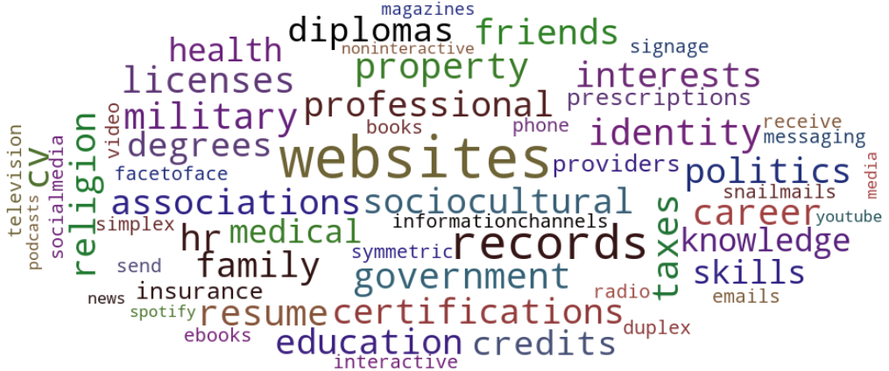
Consumer As Information Ecosystem
Ecosystem: a complex network or interconnected system (https://www.lexico.com/definition/ecosystem)
Components
resources
structures
processes
flows
cycles

Slide 8
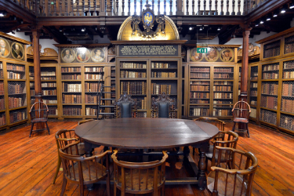
Consumer As Information Recipient (traditional)
Reader
Schools → online classes, MOOC’s
Bookstores → Amazon, eBay, online publishers
Books → eBooks, tablet readers
Magazines, newspapers → publisher websites
Libraries → Project Gutenberg, Wikipedia
Traditional resources PLUS:
Vastly increased choice
Negligible cost of digital reproduction
Global reach
Unlimited portability
Recommender systems
Publish on demand

Slide 9
Traditional Information Flows - Education
textbooks, handouts
lectures, assignments, exams
Instructor
Student
homeworks,
completed exams,
questions
notes,
study sessions
grades
Registrar
Students

Slide 10
Traditional + New Information Flows - Education
textbooks, handouts
3rd-party lessons,
online tutorials,
academic publications,
public databases,
solutions archives
videos,
tutorials,
learning system lessons,
gamification,
active learning
lectures, assignments, exams
Instructor
Student
homeworks,
completed exams,
questions
Powerpoints,
videos,
online posts,
spreadsheets
notes,
study sessions
emails,
texts, collaborative documents
PC’s, laptops, tablets, smartphones, ‘clickers’, electronic whiteboards
Students

Slide 11
Factors of New Information Flows 1
ASYMMETRIC
Business Consumers Businesses
Online Platforms Consumers
SYMMETRIC
Business to Business (competitors)
Consumer to consumer
recommendations
reviews and ratings
forums
Diverse channels
Diverse data types
Big increase in unstructured data
Many more information sources
Increased consumer presence

Slide 12
Factors of New Information Flows 2
STATIC Information Artifacts
Books, e-books
Television, Films, streaming services content
Music CD’s, LP’s, MP3’s
Product catalog information
DYNAMIC Information Processes
Customized content, ads, products, ‘feeds’
Interactive websites
PC, online, and multiplayer Games
Editable content (Wikipedia)
From Mass Market
To
Segmented Market
To Customizable Market
To
Individual Market
Still have Dominant Products – Add new niches, Add ‘market of one’

Slide 13
Factors of New Information Flows 3
PASSIVE
Content consumers
Product users
Recipients of curated information
ACTIVE
Content reproducers (!)
Content distributors (!)
Content remixers (!)
New content creators
Co-designers of products
Co-curators of information
Consumers can potentially intervene at multiple points of the value chain
Special-interest communities and subcultures can organize around brands, genres, celebrities, activities
Still have passively used Products – Add new roles, Add new participants

Slide 14
Factors of New Information Flows 4:
s Information Domains OVERLAP
Information Crossover Platforms:
SOCIAL MEDIA
Texts, emails
Websites
Forums
Chat
Health
Financial
Family
Work
Neighbors & Community
Entertainment
Information Exchange Networks OVERLAP

Slide 15
Product Discovery Case: Electronic Music Overseas
MEG, Perfume, Capsule, Ami Suzuki (performers of Nakata songs)
Family - Children
Cousin Scott
YouTube – Kids React
Synthesizers
Imported CD’s - $$
EDM
Kyary Pamyu – Pon Pon Pon
(song songs)
Sweetwater, B&H $$
Babymetal, Buddy Girl, Judy & Mary
DAW,
Keyboards,
Ultranova,
Soft synths,
recording gear,
RME, UAD
Daft Punk, Brian Eno,
Andy Stott, Aphex Twin
Yasutaka Nakata composer, producer
K-Pop
CD’s - $$
Social media groups
Soundcloud
J-Pop fan sites, lists
Idiotape, Psy, Blackpink, BTS
Estimated expenditures: more than all my [used] cars put together
K-Pop fan sites, lists

Slide 16
Takeaways 1: Constants
Individual human psychology retains limits on capacities
Dunbar’s Number: ~150, max # persons for strong relationships – social groups, subculture clusters
Miller’s Number: 7 + or – 2, or 4 to 7, max # items in short-term memory - “Information Chunking”
Hughes’ Number: 3 + or -1, max # hierarchical levels tracked - click depth to reach desired pages
Attention
limited # hours in one day
Serial tasking exists, multitasking does not
Consumers in permanent information overload
Leverage their overlapping information exchange networks to compensate
Consumers conserve and prioritize their information ecosystem resources

Slide 17
Takeaways 2: Consumer Power Greatly Increased
Information Transparency
Price Comparison
Quality scanning
Reciprocal info curation with other consumers
Interactivity and Digital Control
Selection / Customization
of platforms
of information sources
Appropriation, remix, re-use, re-purpose
Consumers actively nurture and develop their own information ecosystems

Slide 18
Takeaways 3: Information Ubiquity
Occasional task-based Information
Triggered by needs
Intermittent
Consumer information ecosystem becomes primary and indispensable
Work or Leisure-based information
Daily
Linked to identity
Continuous information
24/7
Fully integrated with lifestyle

Slide 19
Takeaways 4: Hyperdifferentation Huge increase in diversity and number
Of Products and Services
Of Market Niches
Of Consumer classifications
Of Providers
Of Opportunities
Consumer information ecosystems grow in richness,
resilience,
sustainability
Look for mutually reinforcing flows, cycles, and processes in Consumer Information Ecosystems

